Slide 1
Number Systems Binary and Hexadecimal
ICS 3U0

Slide 2
Today’s Agenda
Converting between binary and decimal
Converting between hexadecimal and decimal

Slide 3

Decimal System
The number system that we use on a regular basis is the decimal system
It is based on powers of 10
Any number in the decimal system can be represented as a sum of powers of 10

Slide 4
Decimal System - Example
Write 3025 using powers of 10.
3025 = 3000 + 20 + 5
= 3*1000 + 0*100 + 2*10 + 5*1
= 3*10³ + 0*10² + 2*10¹ + 5*10⁰
Notes:
3025 = 3000 + 20 + 5
= 3*1000 + 0*100 + 2*10 + 5*1
= 3*10^3 + 0*10^2 + 2*10^1 + 5*10^0

Slide 5
Binary System
Unlike us, digital computers do not use the decimal number system
In fact, computers do not use "numbers" at all. They use electrical signals that are either ON or OFF.
It is convenient for us to use numbers to represent these two states and typically, we use 1 for ON and 0 for OFF
These two digits (0 and 1) form the binary system

Slide 6
Binary System … Continued
A single binary digit is called a bit
A fixed length string of bits is called a byte
The size of a byte USED to be hardware dependent, but has since been standardized to 8 bits
A 4 bit string(half a byte) is called a nibble ☺

Slide 7

Binary System … Continued
The binary number system is based on powers of two, similar to how the decimal system is based on powers of ten

Slide 8
Example - Binary Number
0 1 1 0 1 1 1 1
This is an example of a binary number
Binary numbers only consist of 0's and 1's
Typically we use 8 bits to represent a binary number (that is … 8 digits)
Each digit has a place value, just like with ordinary, everyday numbers

Slide 9
Example - Binary to Decimal
So, what decimal number (base 10) does this binary number represent?
0 1 1 0 1 1 1 1
= 0*2⁷ + 1*2⁶ + 1*2⁵ + 0*2⁴ + 1*2³ + 1*2² + 1*2¹ + 1*2⁰
= 0*128 + 1*64 + 1*32 + 0*16 + 1*8 + 1*4 + 1*2 + 1*1
= 0 + 64 + 32 + 0 + 8 + 4 + 2 + 1
= 111
This means 01101111₂ = 111₁₀
Notes:
= 0*2^7 + 1*2^6 + 1*2^5 +0*2^4 + 1*2^3 + 1*2^2 + 1*2^1 + 1*2^0
= 0*128 + 1*64 + 1*32 + 0*16 + 1*8 + 1*4 + 1*2 + 1*1
= 0 + 64 + 32 + 0 + 8 + 4 + 2 + 1
= 111

Slide 10
Converting from Binary to Decimal
Example: Convert the following binary numbers to decimal numbers.
00101001 10000101
Notes:
Answer: 41 and 133

Slide 11
Example – Decimal to Binary
Now, let's go the other way … what binary number does this decimal number represent?
98
= 64 + 32 + 2
= 2⁶ + 2⁵ + 2¹
= 0*2⁷ + 1*2⁶ + 1*2⁵ ⁺ 0*2⁴ ⁺ 0*2³ + 0*2² + 1*2¹ + 0*2⁰
= 01100010
This means 98₁₀ = 01100010₂
Notes:
Answer: 01100010

Slide 12
Converting from Decimal to Binary
Example: Convert the following decimal numbers to binary numbers.
23 127
Notes:
Answer: 00010111 and 01111111

Slide 13
Hexadecimal System
Hexadecimal is a number system that uses 16 digits
Hex codes are used in many areas of computing to simplify binary codes. Note: Computers do not use hexadecimal - it is used by humans to shorten binary to a more easily understandable form. Hexadecimal is translated into binary for computer use.
Some examples of where hex is used include:
colour references
assembly language programs
error messages

Slide 14

Hex System … Continued
The hexadecimal number system is based on powers of 16, similar to how the decimal system is based on powers of ten and the binary system is based on powers of 2

Slide 15
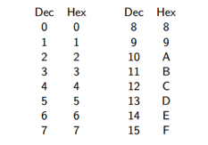
Hex System … Continued
The hexadecimal system uses 16 digits … since we do not have a single digit value that goes beyond 9, we use the letters A-F instead.

Slide 16
Example – Hex Number
0xA19
This is an example of a hexadecimal number
The 0x means NOTHING mathematically. It is notation that is used to indicate that the number that follows is a hexadecimal number.
Hexadecimal numbers consist of the numbers 0-9 and letters A-F
Each digit has a place value, just like with ordinary, everyday numbers and binary numbers

Slide 17
Example – Hex to Decimal
So, what decimal number (base 10) does this hexadecimal number represent?
0xA19
A19 = A*16² + 1*16¹ + 9*16⁰
= 10*16² + 1*16¹ + 9*16⁰
= 2560 + 16 + 9
= 2585

Slide 18
Converting from Hex to Decimal
Example: Convert the following hexadecimal numbers to decimal numbers.
0x2FA0 0x19B
Notes:
Answer: 12192 and 411

Slide 19
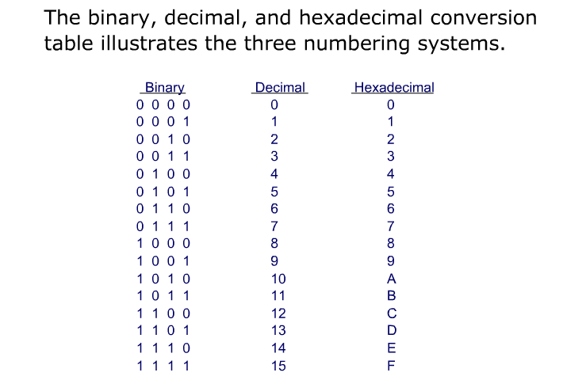
In Summary …

Slide 20
Exercises – Number Systems
Complete
Exercise 3.3 – Number Systems

Slide 21
Coding Decimal to Binary/Hex Conversion
We can use this code to help us write a program to convert from decimal to binary/hexadecimal:
num = int(input("Enter a positive integer:"))
while num >= 1:
digit = num % 10
num = num//10
print(digit)

Slide 22
Coding Binary/Hex to Decimal Conversion
How can we do this?
What do you think?

